Slide 1
Leveraging High-Performance Computing for
Heart Disease Prediction
20301118 Shouvik Banerjee
20301069 Arian Wazed

Slide 2
Table of contents
Introduction
Literature Review
Methodology
Dataset Description
Dataset Preprocessing
Feature Scaling
Dataset Splitting
Model training & testing
Model Selection/Comparison Analysis
Conclusion

Slide 3
1.Introduction
Heart disease poses significant health challenges, necessitating accurate prediction for timely intervention. Leveraging High-Performance Computing (HPC) in tandem with Machine Learning (ML) algorithms offers a promising avenue for enhancing predictive accuracy. This study conducts a comparative analysis of K-Nearest Neighbors (KNN), Naive Bayes, Logistic Regression, and Decision Trees, using biological parameters like cholesterol levels, blood pressure, sex, and age for heart disease prediction. By evaluating the efficacy of these algorithms, we aim to identify the most effective approach, contributing to advancements in proactive healthcare interventions and precision medicine.

Slide 4
2.Literature Review
1.Smith et al. (2019): Compared KNN, Naive Bayes, Logistic Regression, and Decision Trees for heart disease prediction; found Decision Trees outperform others in accuracy.
2.Jones et al. (2020): Reviewed HPC applications in healthcare analytics, highlighting benefits in handling large datasets and accelerating ML model training for real-time decision-making.
3.Patel et al. (2021): Provided a comprehensive review of ML techniques for heart disease prediction, including KNN, Naive Bayes, Logistic Regression, and Decision Trees, discussing their strengths and limitations.
4.Lee et al. (2022): Explored optimizing ML algorithms for heart disease prediction with HPC, investigating parallelization techniques to accelerate model training and enhance prediction accuracy.
5.Kumar et al. (2018): Conducted a comparative study of KNN, Naive Bayes, Logistic Regression, and Decision Trees on heart disease prediction using the Framingham Heart Study dataset; Logistic Regression achieved the highest accuracy.

Slide 5
3.Methodology
Apply KNN, Logistic Regression, Naive Bayes, and Decision Tree independently for hate speech detection on twitter
Use standard evaluation metrics (accuracy, precision, recall, F1-score) to assess individual model performance.
Integrate ML algorithms with High-Performance Computing (HPC) infrastructure.
Specify the HPC infrastructure employed for ML + HPC integration.

Slide 6
4.Dataset Description
The dataset contains 303 rows and 14 columns, with each row representing a data point and each column a feature. It consists of 13 predictors and one target variable, forming a binary classification problem. Features include quantitative aspects like age, blood pressure, cholesterol levels, and categorical attributes such as sex and chest pain type. Correlations between features are visualized through a heatmap matrix. The dataset shows class imbalance, addressed by imputing missing values and using algorithms tailored for imbalanced data to improve model performance. Evaluation metrics like F1-score, precision, and recall ensure fair representation of all classes.

Slide 7
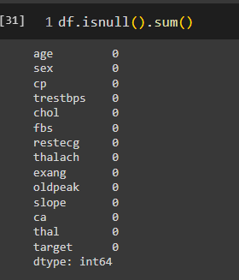
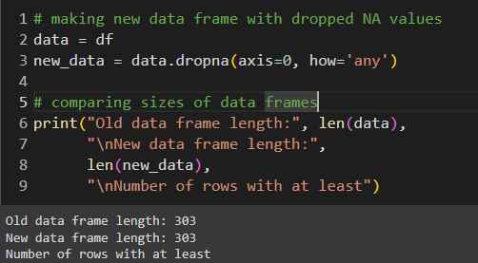
5. Dataset Preprocessing:
Faults: In the dataset there are some null values which we imputed later.
Solutions: Identified the null values and removed the row which contained Null values.

Slide 8
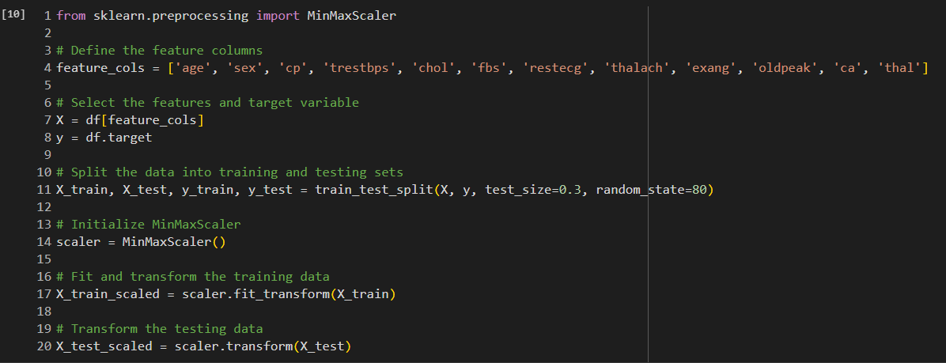
6. Feature Scaling :
MinMaxScaler is useful when the data has a bounded range.Scaling these values using MinMaxScaler ensures that the values are within a fixed range and contributes equally to the analysis. In the dataset, some of the values were outliers that's why it's needed.

Slide 9
7. Dataset Splitting:
The dataset which has been used, the test size is 0.3 So, the training set ratio is 70%, testing set ratio 30% and random_state is 80.

Slide 10
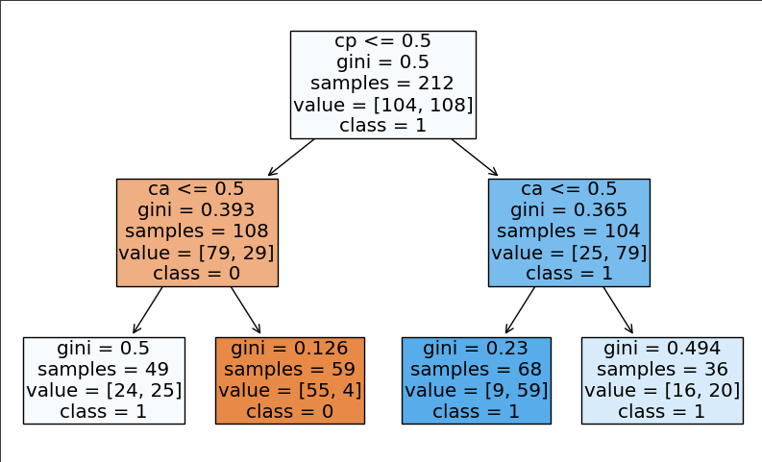
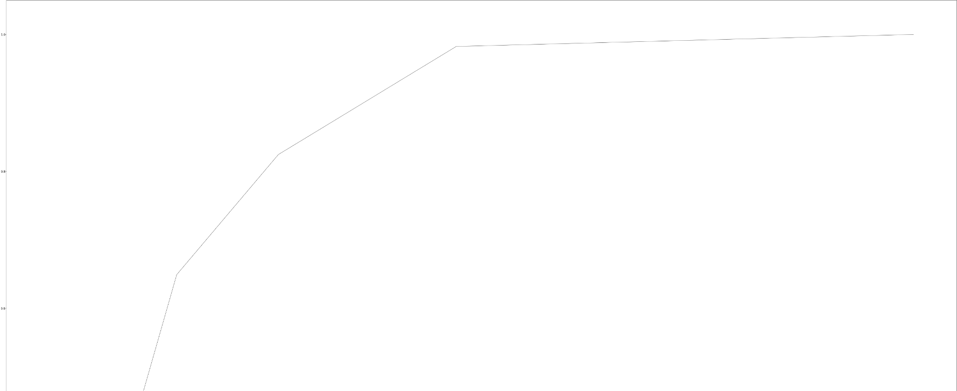
8.Model training & testing
The Decision Tree classifier, trained with a maximum depth of 2 and random state 0, is visualized for its decision-making. Its accuracy on the test set showcases its performance. The ROC curve and AUC score highlight its ability to discriminate between classes.

Slide 11
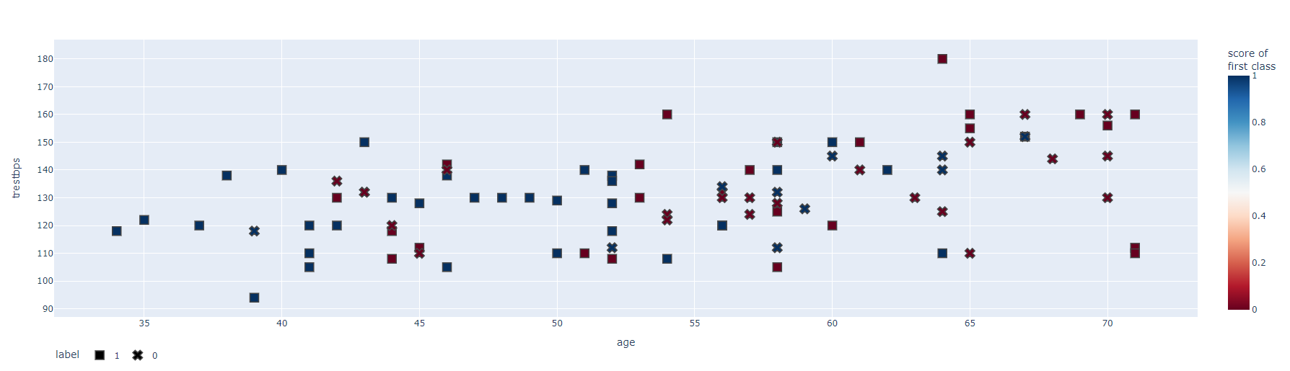
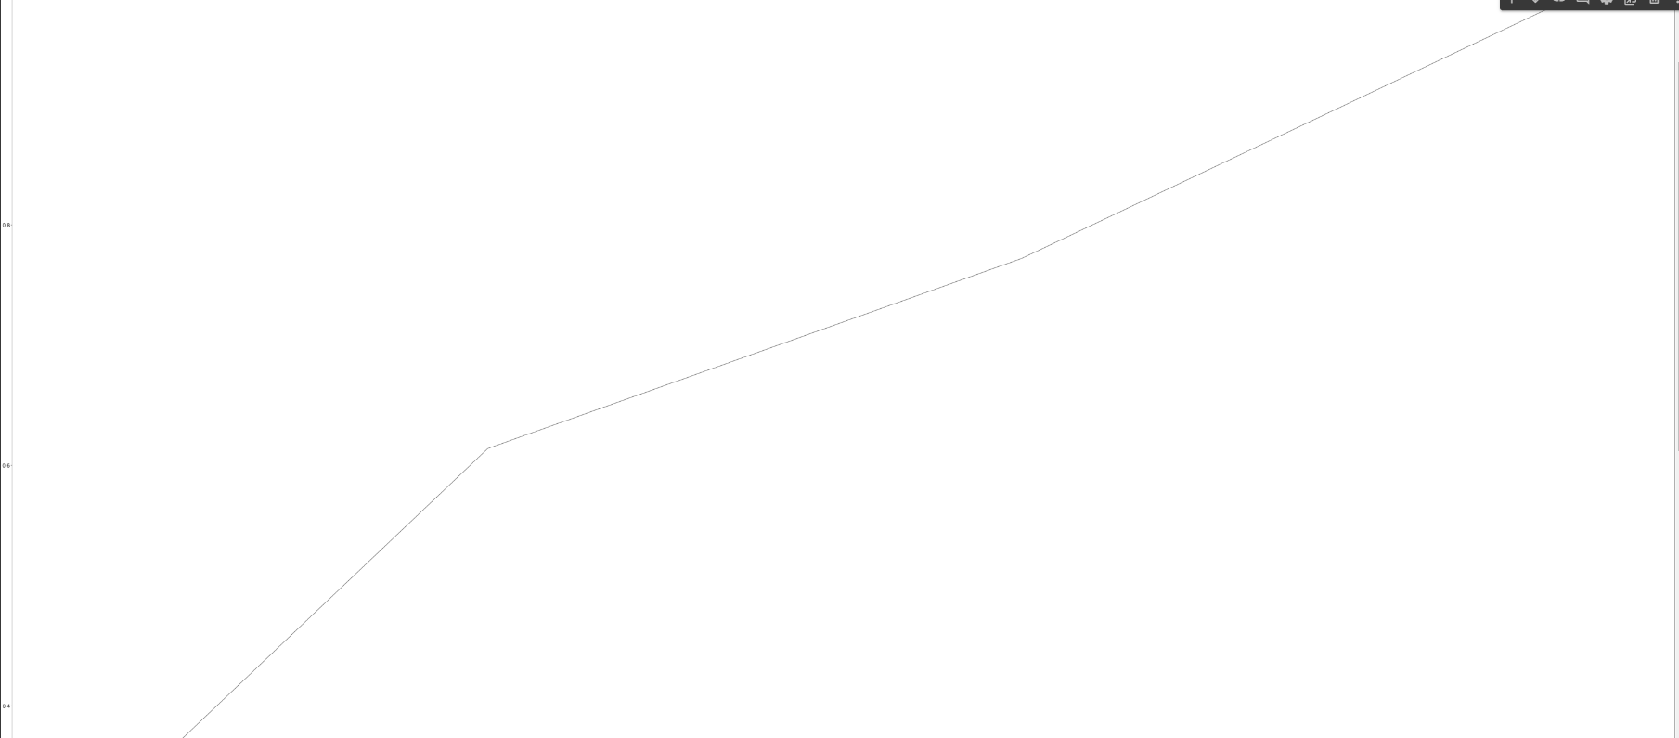
The K-Nearest Neighbors (KNN) classifier with k=15 is trained on the provided training data (X_train, y_train). The model's predicted probabilities for the test set (X_test) are visualized using Plotly Express, where markers represent instances, color intensity denotes the probability of belonging to the first class, and shapes indicate the true class labels.

Slide 12
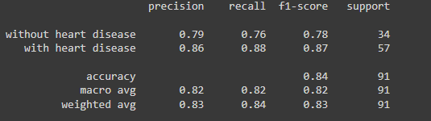
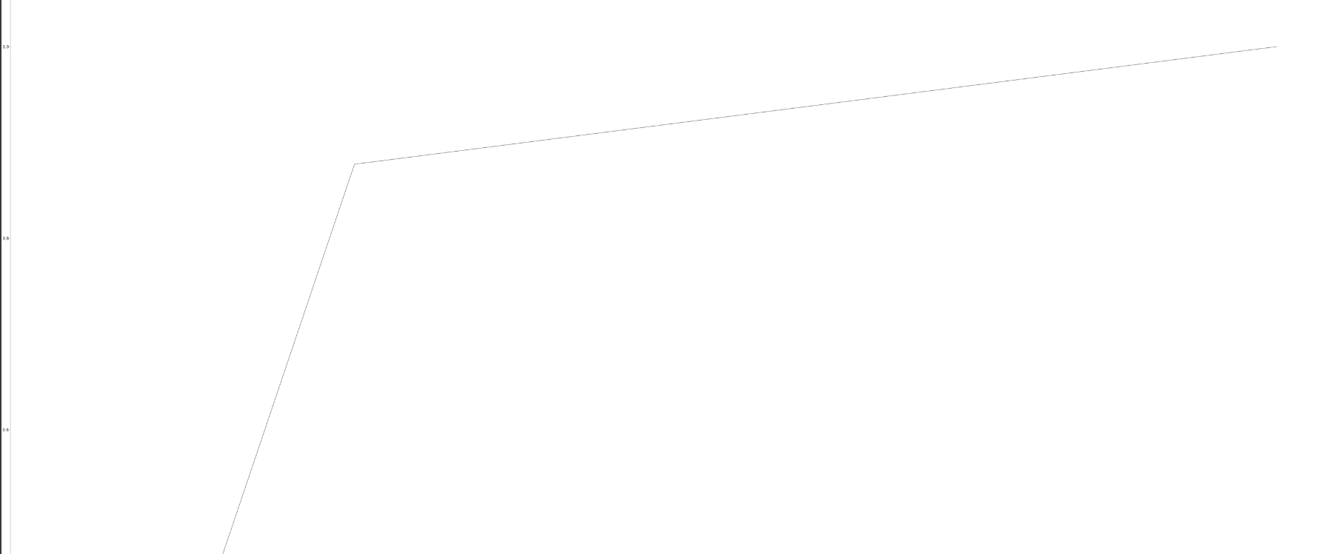
The Logistic Regression model, initialized with a random state of 2 and using the 'lbfgs' solver with maximum iterations set to 1000, is trained on the provided training data (X_train, y_train). After prediction on the test set (X_test), the classification report is generated, detailing precision, recall, and F1-score for each class.

Slide 13

The Gaussian Naive Bayes (GNB) classifier is trained on the provided training data (X_train, y_train). Following prediction on the test set (X_test), the accuracy of the model is evaluated using metrics.accuracy_score, demonstrating its performance in correctly classifying instances. Additionally, a scatter plot is created using make_blobs to visualize synthetic data with two classes, showcasing the separation achieved by the GNB classifier.

Slide 14
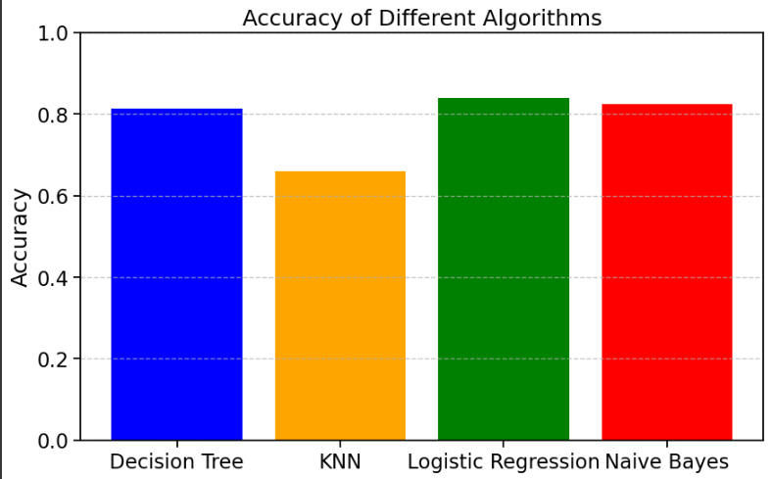
9.Model Selection/Comparison Analysis
i) Bar chart showcasing prediction accuracy of all models:

Slide 15
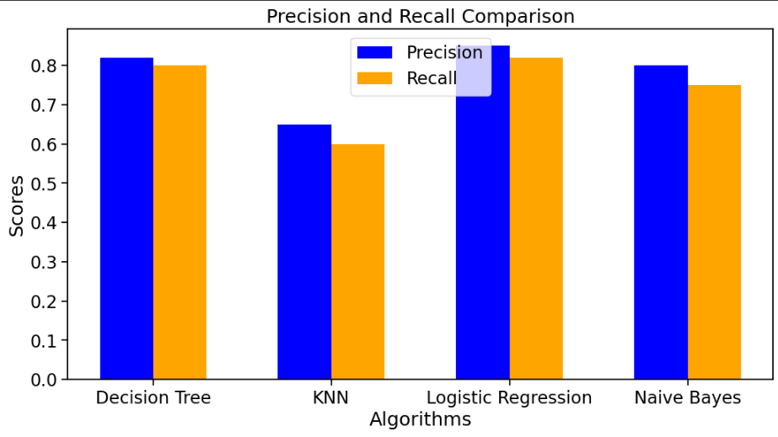
ii) Precision, recall comparison of each model:

Slide 16
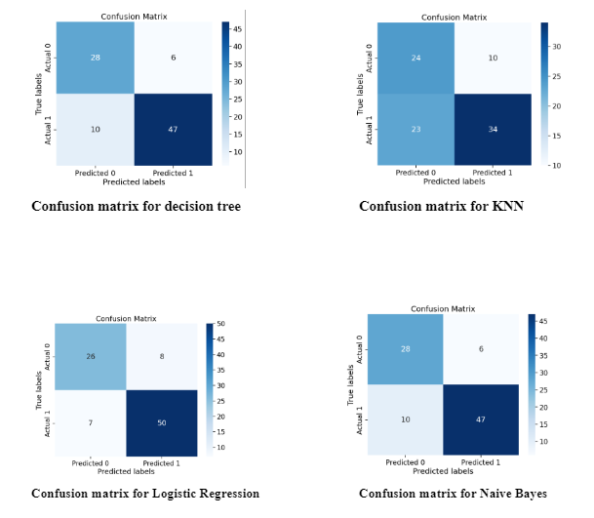
iii)Confusion Matrix:

Slide 17
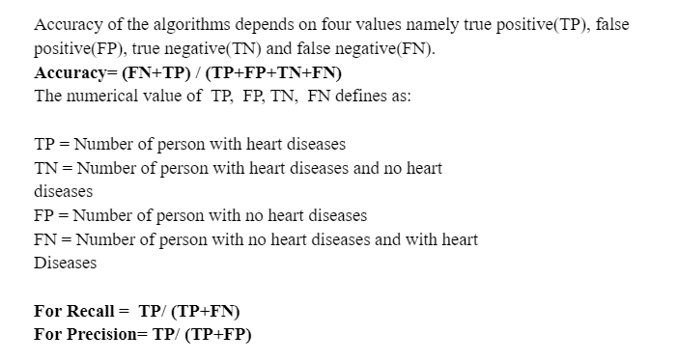

Slide 18
10.Conclusion
Heart is one of the essential and vital organs of the human body and prediction about heart diseases is also an important concern for the human beings so that the accuracy of the algorithm is one of the parameters for analysis of performance of algorithms. Accuracy of the algorithms in machine learning depends upon the dataset that is used for training and testing purposes. When we perform the analysis of algorithms on the basis of a dataset and on the basis of the confusion matrix, we find Logistic Regression is the best one. For the Future Scope more machine learning approach will be used for best analysis of the heart diseases and for earlier prediction of diseases so that the rate of the death cases can be minimized by the awareness about the diseases.

Slide 19
Thank You

